Slide 1
Collaborative Platform Version 6.0
Team Members
Mandiel Lastra (Developer)
Michael Machin (Developer)

Slide 2
Problem
Current students lack a reliable source for answering questions related to their classes or projects in a timely manner.
Students may rely on several sources, often unreliable, inaccurate, and incomplete.
There exists a difficulty matching the right subject matter expert to the right question
Professionals in the field lack an accessible way of being able to mentor students.

Slide 3
Problem
Solution
List of domains have to be populated by administrator
Questions can be assigned to mentors who are out of office
Questions stay assigned indefinitely regardless of priority
Questions are not assigned evenly
The same questions will be asked over and over
The mentor has to try to find the question in their queue when they receive it
Prospective mentors are able to suggest a domain.
Track mentors who are out of office and stop assigning questions to them
Assign questions to new mentors when the question runs out of time
Assign questions to mentors using round robin
Allow users to look up old questions.
Send the information, and link, of the ticket in the email.

Slide 4
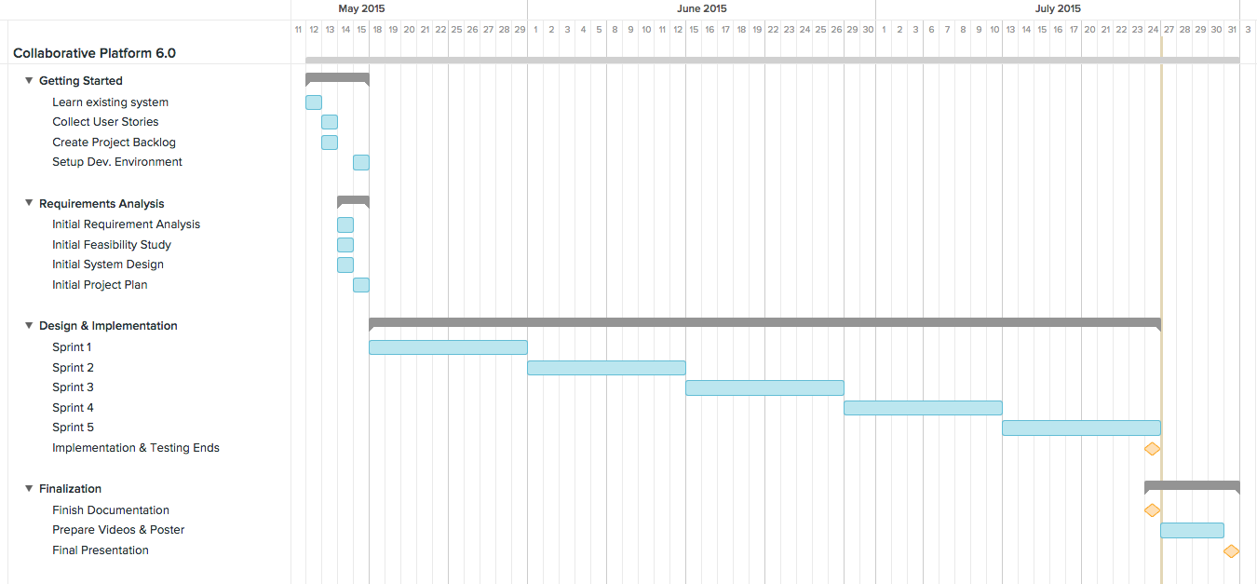
Project Management

Slide 5
Implemented User Stories
Do not auto assign tickets to unavailable mentors
Send an email to the mentor signifying their unavailable status
Mentors on list are selected by round robin in domain
Tickets are reassigned after a set time of no mentor response
Bug: Ttickets can not have an uploaded file
Set mentors as unavailable upon receiving an Out of Office reply
Reassign tickets that were assigned to an unabailable mentor.
Allow mentor to reject a ticket from their email.
Allow the system admin to set and change reassign rules
Send information of ticket through email
Emails sent throught the system are validated
Allow mentors to remove themselves from the away list
Allow the system admin to manage away mentors.
Allow system adminr to add to away list using the user’s name and autocomplete
Bug: Personal mentors are not being registered correctly
Improve usability of the system

Slide 6
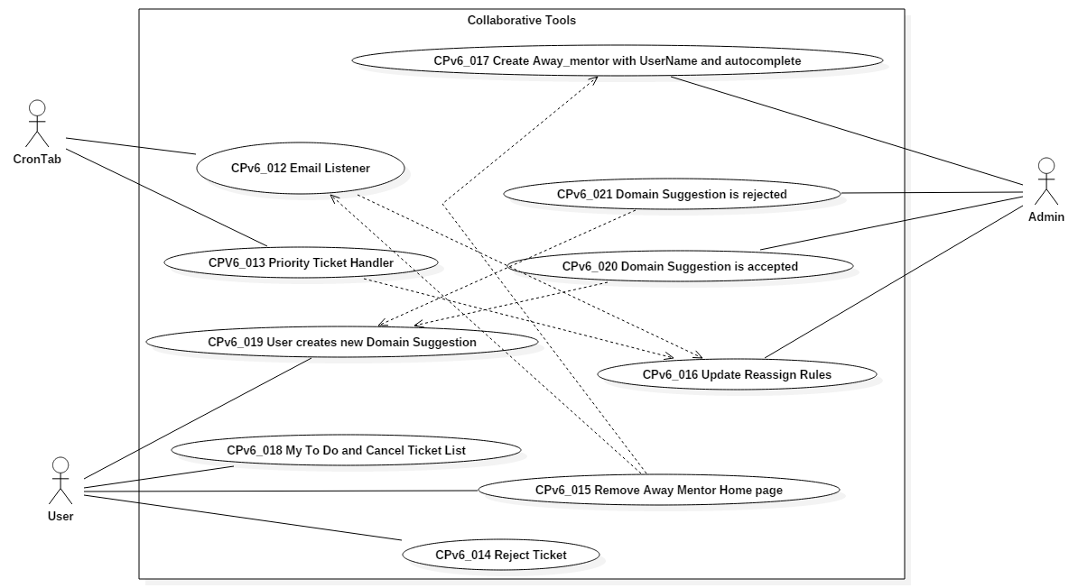
Use Cases

Slide 7
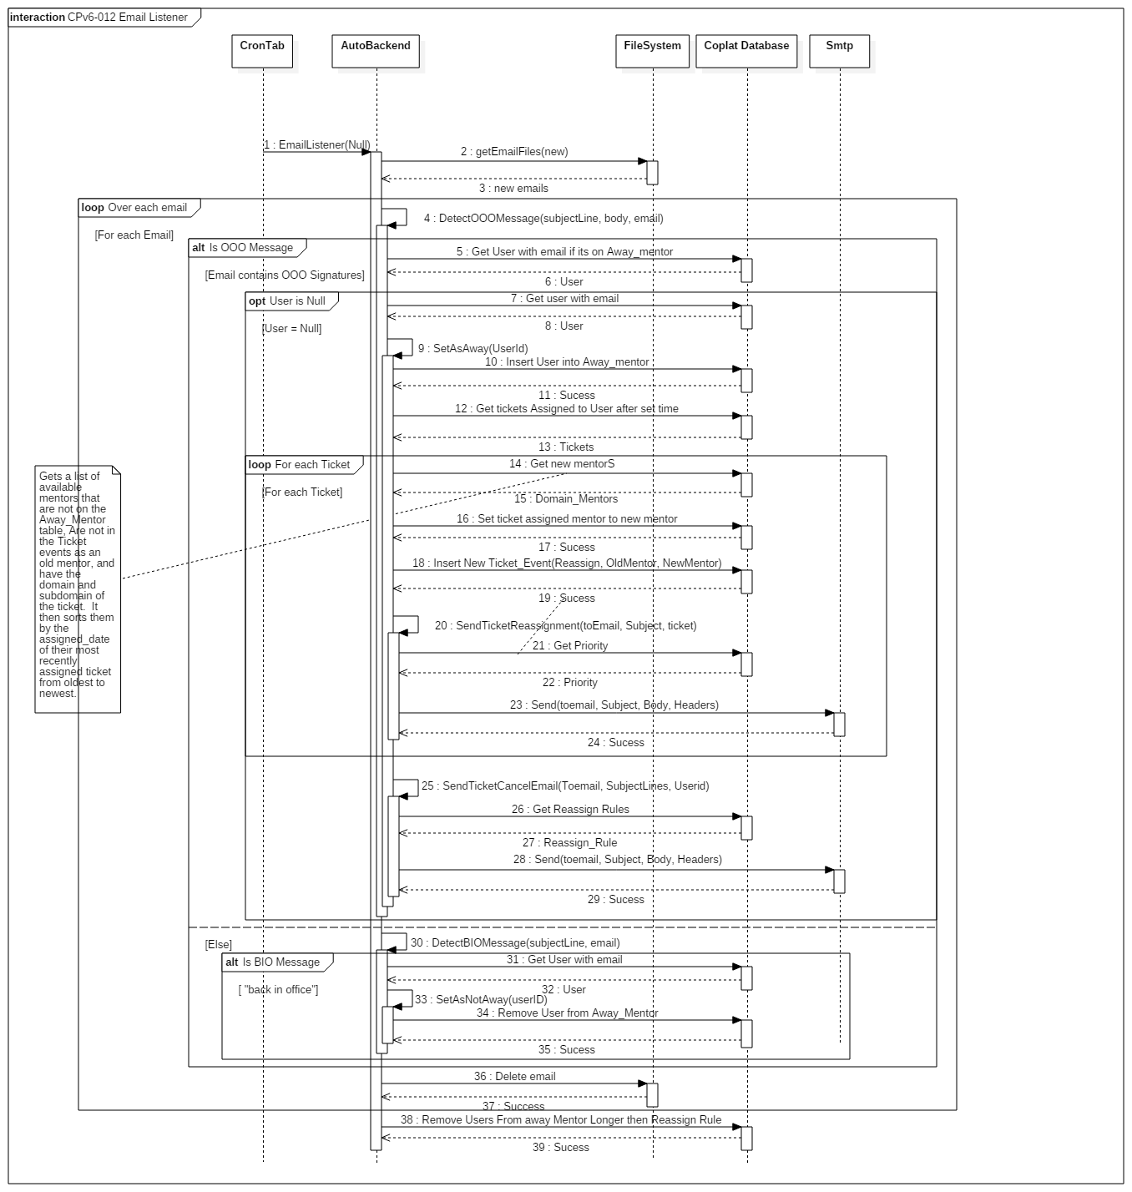
Sequence Diagrams

Slide 8
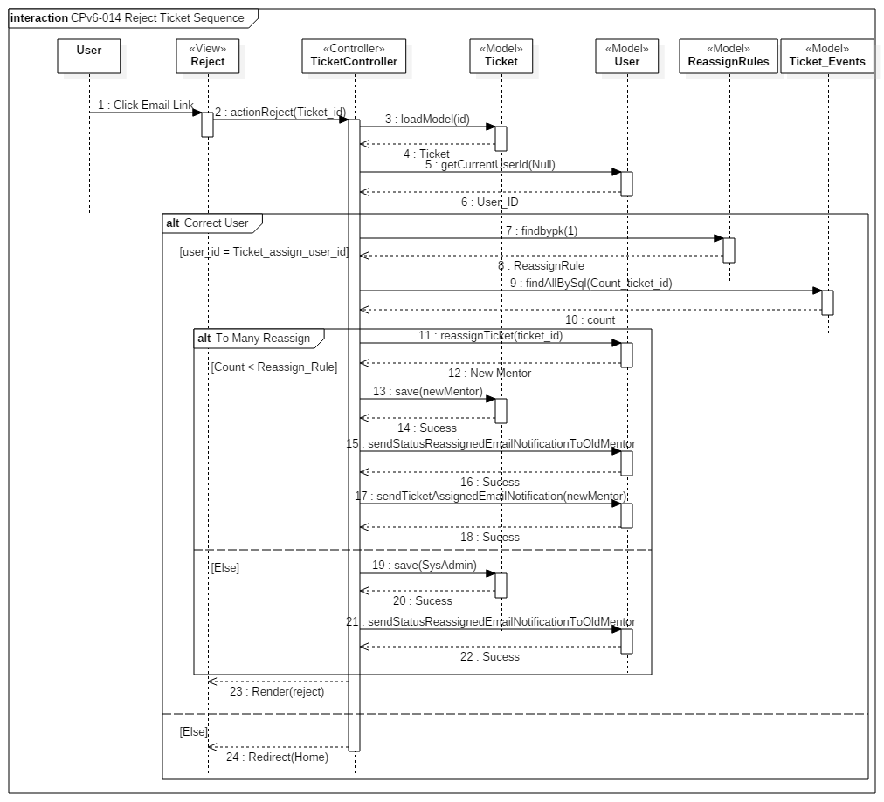
Sequence Diagrams

Slide 9
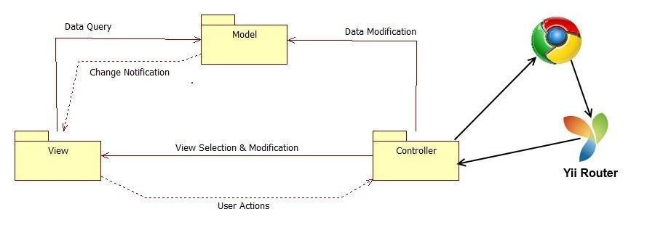
System Decomposition

Slide 10
System Deployment
Minimum Hardware
Minimum Software
Processor | 1.6 GHz
RAM | 256 MB
CPU op-model(s) | 32-bit
Database Server | MySql 5.5
Web Server | Apache 2.0
Server-side Scripting | PHP 5.5
Operating System | Windows, Linux, Mac OS

Slide 11
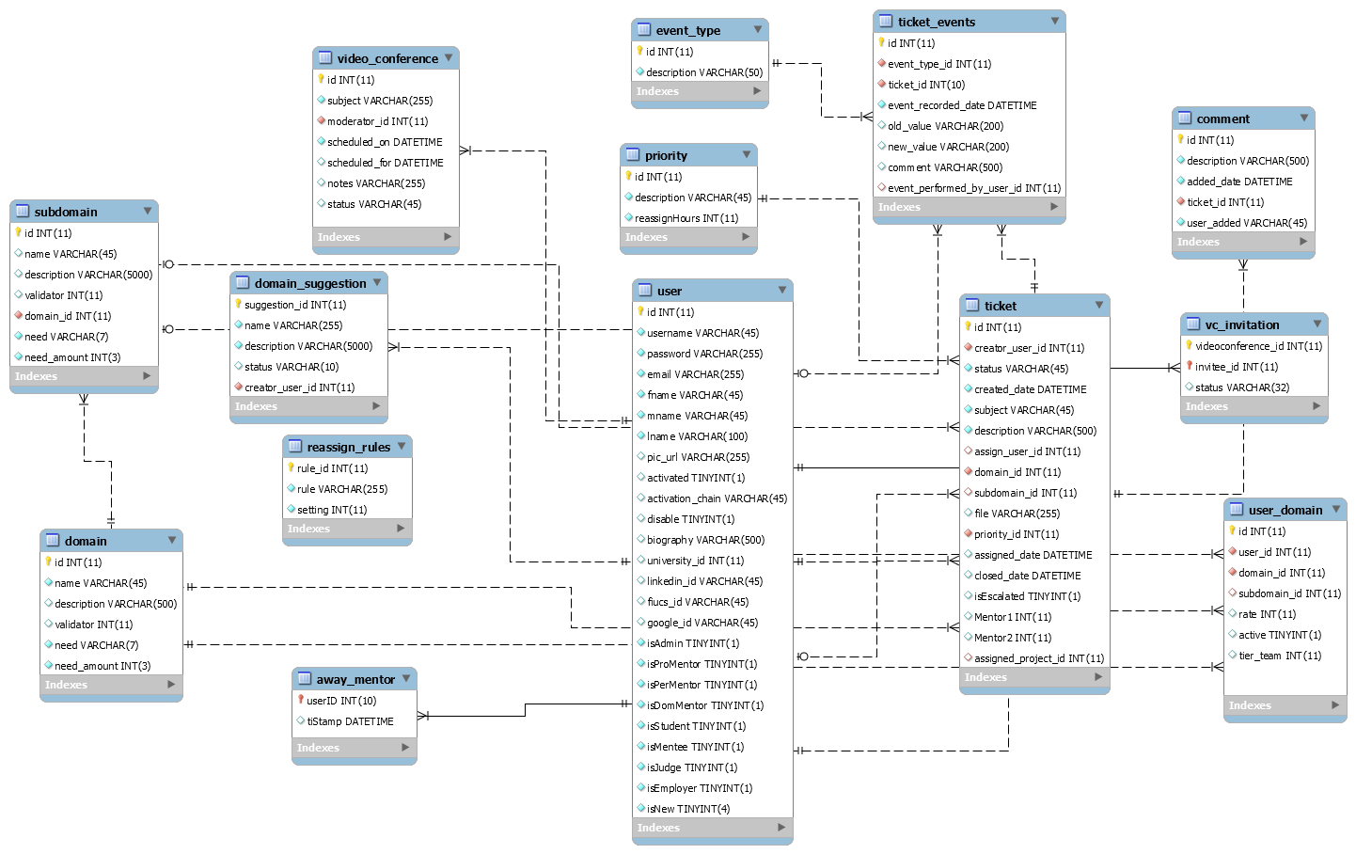
ER Diagram

Slide 12
Security/Privacy
Yii access control rules
Yii Cross-site scripting prevention
Password hashing
Secure registration process

Slide 13
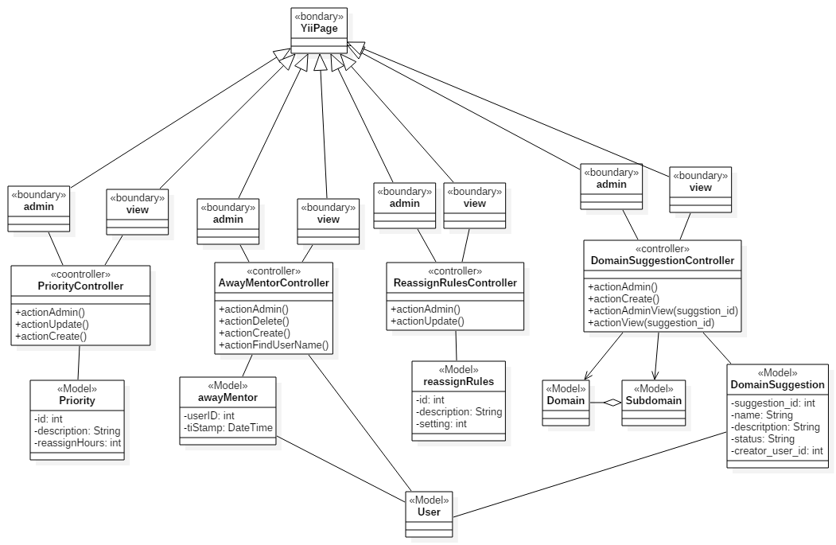
Minimal Class Diagram

Slide 14
Algorithm For Email Handler
Collect Emails sent to system
Check each email for “out of office” qualifiers
If email has out of office qualifiers find the user with email’s from address
If the email is attached to a user, add that user to the away_mentor table
Find all tickets assigned within “Reassign Rules hours
For each ticket:
Append the tickets subject to “subjects” string
Find a new appropriate mentor
Assign the ticket to a new mentor
Email the new mentor
Record the ticket event
Email the “out of office” mentor their tickets that have been reassign and notify them of being away.

Slide 15
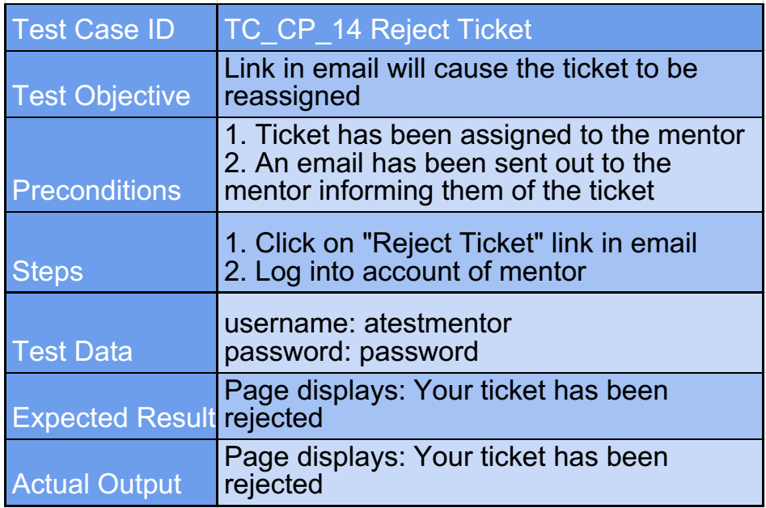
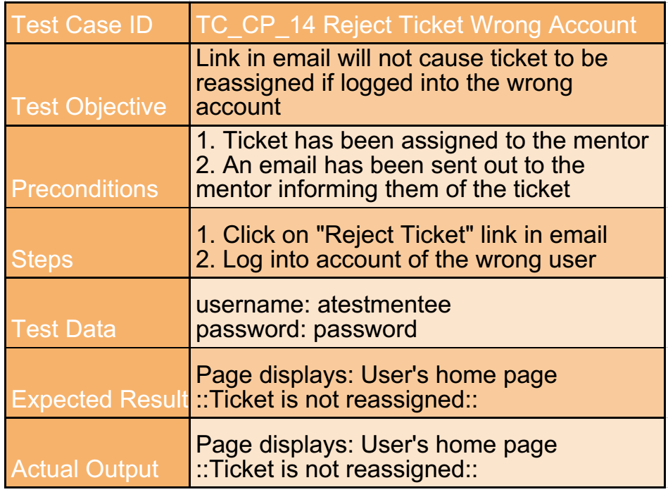
Test Cases

Slide 16
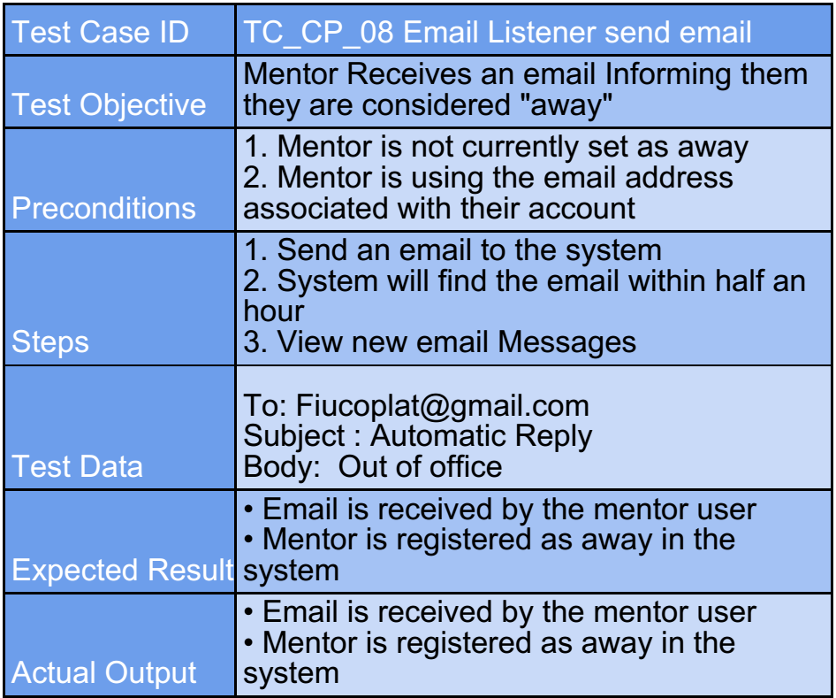
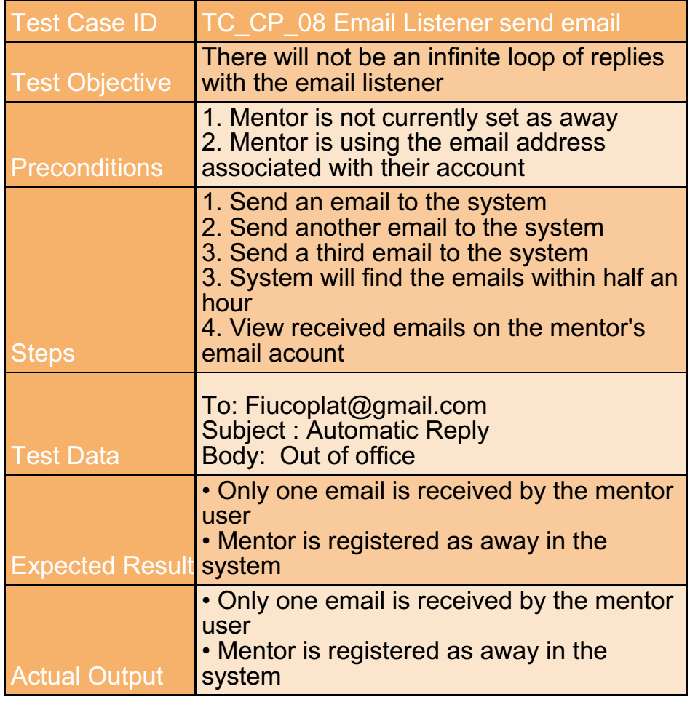
Test Cases

